Slide 1
Viral Gastroenteritis

Slide 2
Viral gastroenteritis is an inflammation of the mucosal lining of gastrointestinal tract commonly caused by Rotavirus, Norovirus, astrovirus and Adenoviruses.
Mainly presented with nauses, vomiting and watery diarrhea.
The most important concern is dehydration from loss of fluid especially in children.

Slide 3
ROTAVIRUS

Slide 4
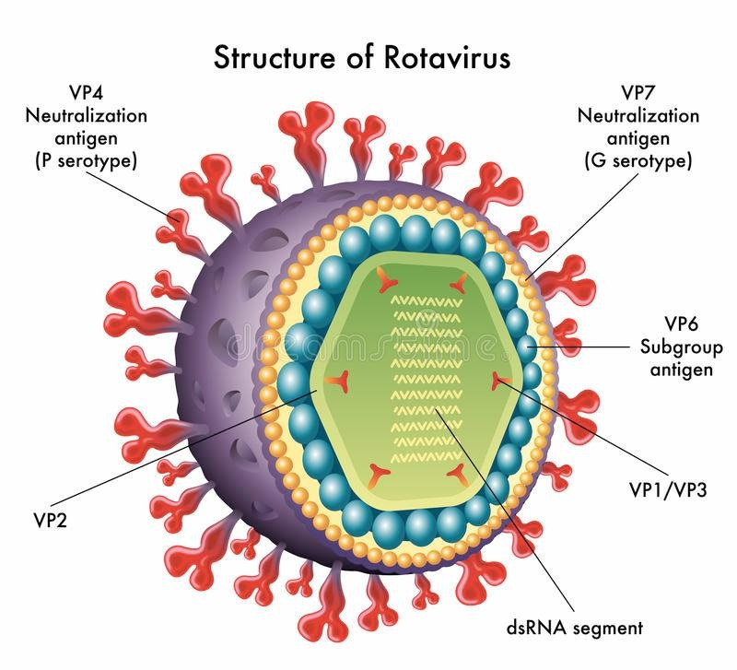

Slide 5
Important properties
The name rota virus is derived from the characteristic wheel like appearance of the virus by electron microscope (rota=wheel).
Rotavirus has a segmented, double-stranded RNA genome surrounded by icosahedral capsid without an envelope. The rotavirus genome has 11 segments.

Slide 6
Important Properties
The virion contains an RNA-dependent RNA polymerase. A virion
polymerase is required because human cells do not have an RNA polymerase that can synthesize mRNA from a double-stranded RNA template.
There are at least six serotypes of human rotavirus.
The outer surface protein (also known as the viral hemagglutinin) is the type-specific antigen and elicits protective antibody

Slide 7
Transmission & Epidemiology
Rotavirus is most common cause of severe gastroenteritis in young children. Before the development of a vaccine, most children had been infected with the virus at least once by age 5.
Rotavirus is highly contagious(low infectivity dose) transmitted by the fecal–oral route.
By the age of 6 years, most children have antibodies to at least one serotype

Slide 8
Pathogenesis & Immunity
Rotavirus replicates in the mucosal cells of the small intestine, resulting in the excess secretion of fluids and electrolytes into the bowel lumen.
The consequent loss of salt, glucose, and water leads to diarrhea. No inflammation occurs, and the diarrhea is non bloody.
Immunity to rotavirus infection is unclear. It is likely that intestinal IgA directed against specific serotypes protects against reinfection and that colostrum IgA protects newborns up to the age of 6 months

Slide 9
Clinical Findings
Diarrhea (watery not bloody)
nausea/ vomiting
Dehydration
Gastroenteritis is most serious in young children and immunocompromised, Adults usually have minor symptoms.

Slide 10
Laboratory Diagnosis
Diagnosis is often clinical.
Detection of rotavirus in the stool
ELISA or PCR
fourfold or greater rise in antibody titer
Although the virus can be cultured, this procedure is not routinely done.

Slide 11
Treatment & Prevention
There are two oral rotavirus vaccines available:
1. live attenuated vaccine (Rotarix), which contains the single most common rotavirus serotype
2. live reassortant vaccine (Rotateq), which contains five rotavirus strains in which the gene for the outer surface protein of a human rotavirus is inserted into a bovine strain of rotavirus (nonpathogenic for humans)
The vaccine elicits protective (IgA) immunity in the gastrointestinal tract.

Slide 12
Caliciviruses
Human caliciviruses cause clearly defined outbreaks that affect adults, school-aged children and family contacts; infrequently, these outbreaks involve infants and young children
Norwalk virus is an important norovirus and is named for an outbreak of gastroenteritis in a school in Norwalk.
Norovirus has a nonsegmented, single-stranded, positive-polarity RNA genome. It is a nonenveloped virus with an icosahedral nucleocapsid. There is no polymerase within the virion.

Slide 13
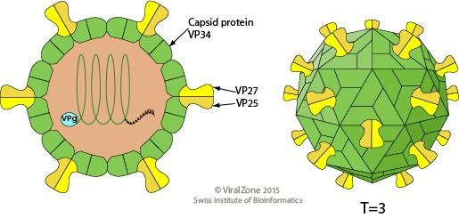
ASTROVIRUSES
Astroviruses are nonenveloped RNA viruses. They have a characteristic five- or six-pointed morphology.
These viruses cause watery diarrhea, especially in children. Most adults have antibodies against astroviruses, No antiviral drugs or preventive measures are available.

Slide 14
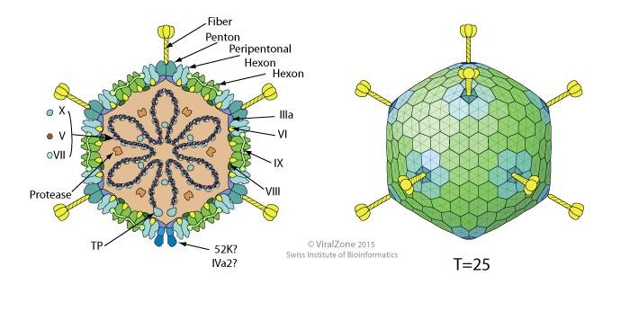
Adenoviruses
Nonenveloped dsDNA with icosahedral symmetry.
Types 40 and 41 cause infantile gastroenteritis.

Slide 15
Thanks

